Slide 1
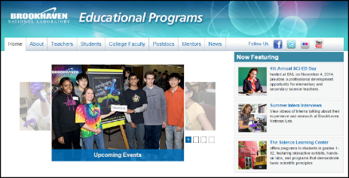
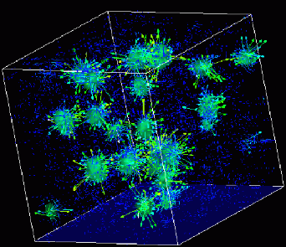
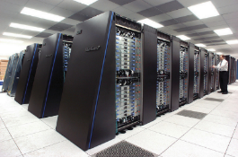
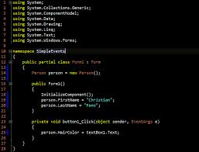
Advanced
Scientific Computing
(SciComp 201)
Session 27
Differential Equations

Slide 2
Session Goals
Implement Euler’s Method for finding numerical solutions to physical laws represented as differential equations
Derives Euler’s Method directly from the expression for the general form of a first derivative
Model the radioactive decay of Flourine-18 and Carbon-14
Use Euler’s Method to model the simple harmonic motion of a single (unforced, undamped) pendulum
Appreciate the importance of stability in numerical solutions
Use the Euler-Cromer method to eliminate artificial energy gain in the long-term modelling of a system
Determine the trajectory of a two pendulum Harmonograph

Slide 3







Modelling Nuclear Decay
$N\left(t\right)≡$ number of nuclei at time t
$τ≡$ mean lifetime (half life)
$$\frac{dN}{dt}=−\frac{N}{τ}$$
$$N\left(t\right)=N(0)e^{−\frac{t}{τ}}$$
$$\frac{dN}{dt}=\frac{N\left(t+Δt\right)−N(t)}{Δt}$$
$$−\frac{N}{τ}=\frac{N\left(t+Δt\right)−N(t)}{Δt}$$
$$N\left(t+Δt\right)=N\left(t\right)−\frac{N(t)}{τ}Δt$$

Slide 4
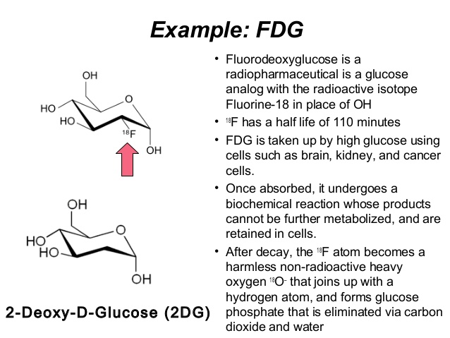
Flourine-18

Slide 5
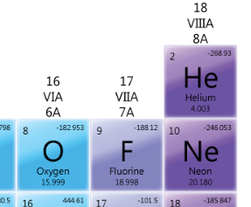
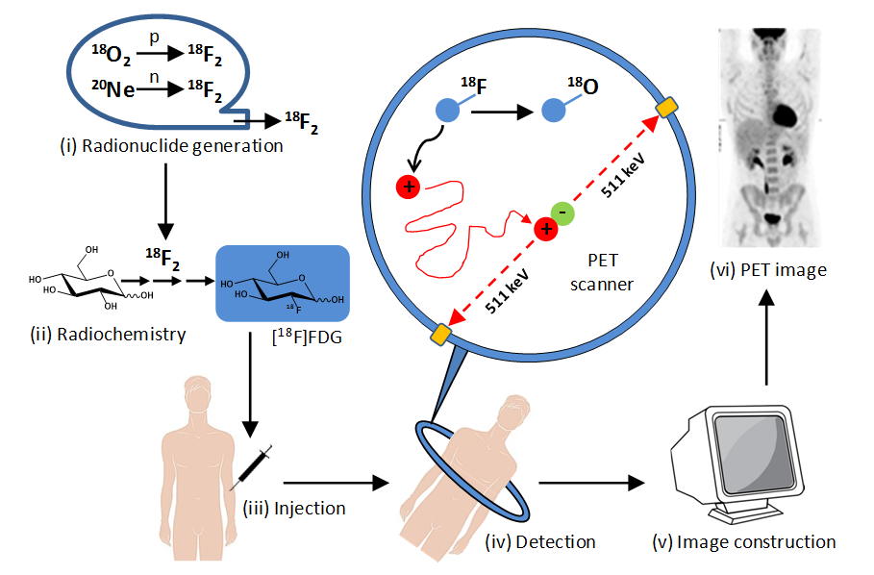
Flourine-18

Slide 6
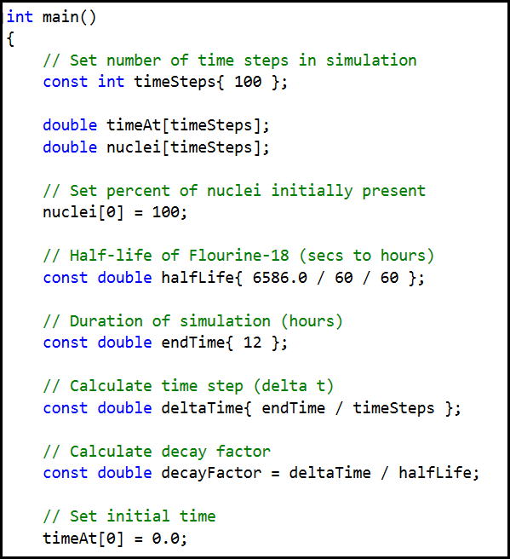
Lab 1 – Euler’s Method

Slide 7
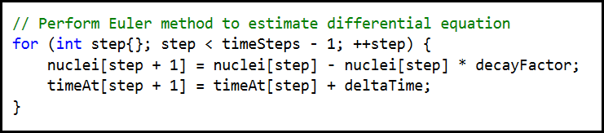


Lab 1 – Euler’s Method
$$\frac{dN}{dt}=−\frac{N}{τ}$$
$$N\left(t+Δt\right)=N\left(t\right)−\frac{N(t)}{τ}Δt$$

Slide 8
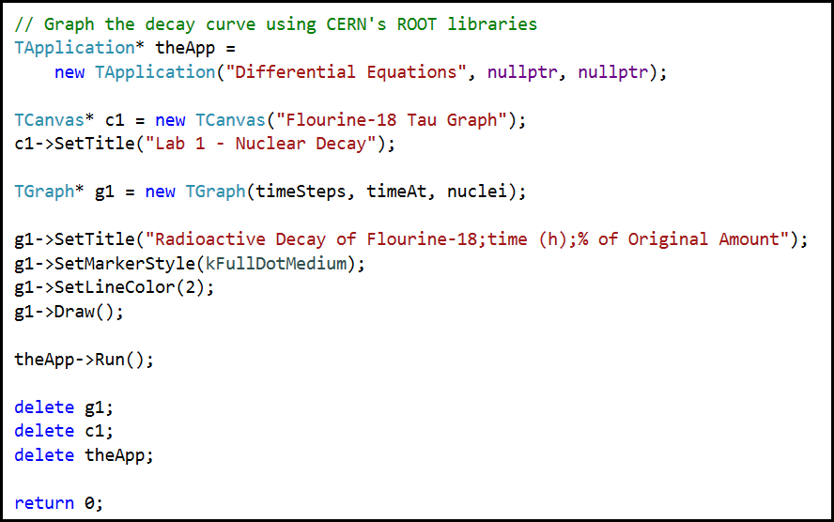
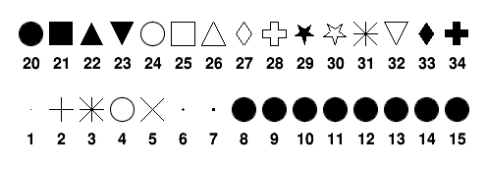
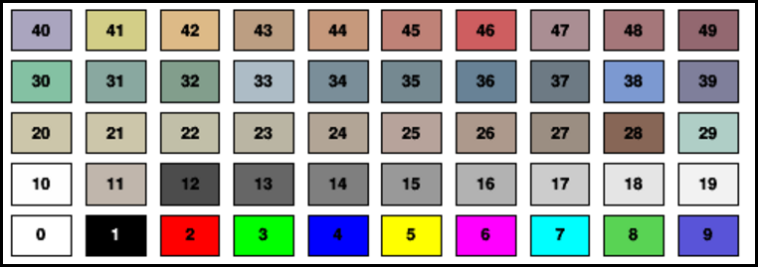
Lab 1 – Euler’s Method

Slide 9
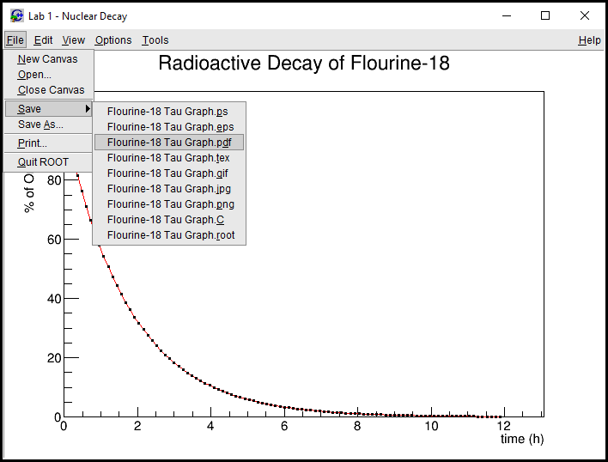
Lab 1- Euler’s Method

Slide 10
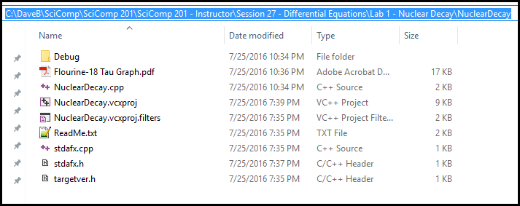
Lab 1 – Euler’s Method

Slide 11
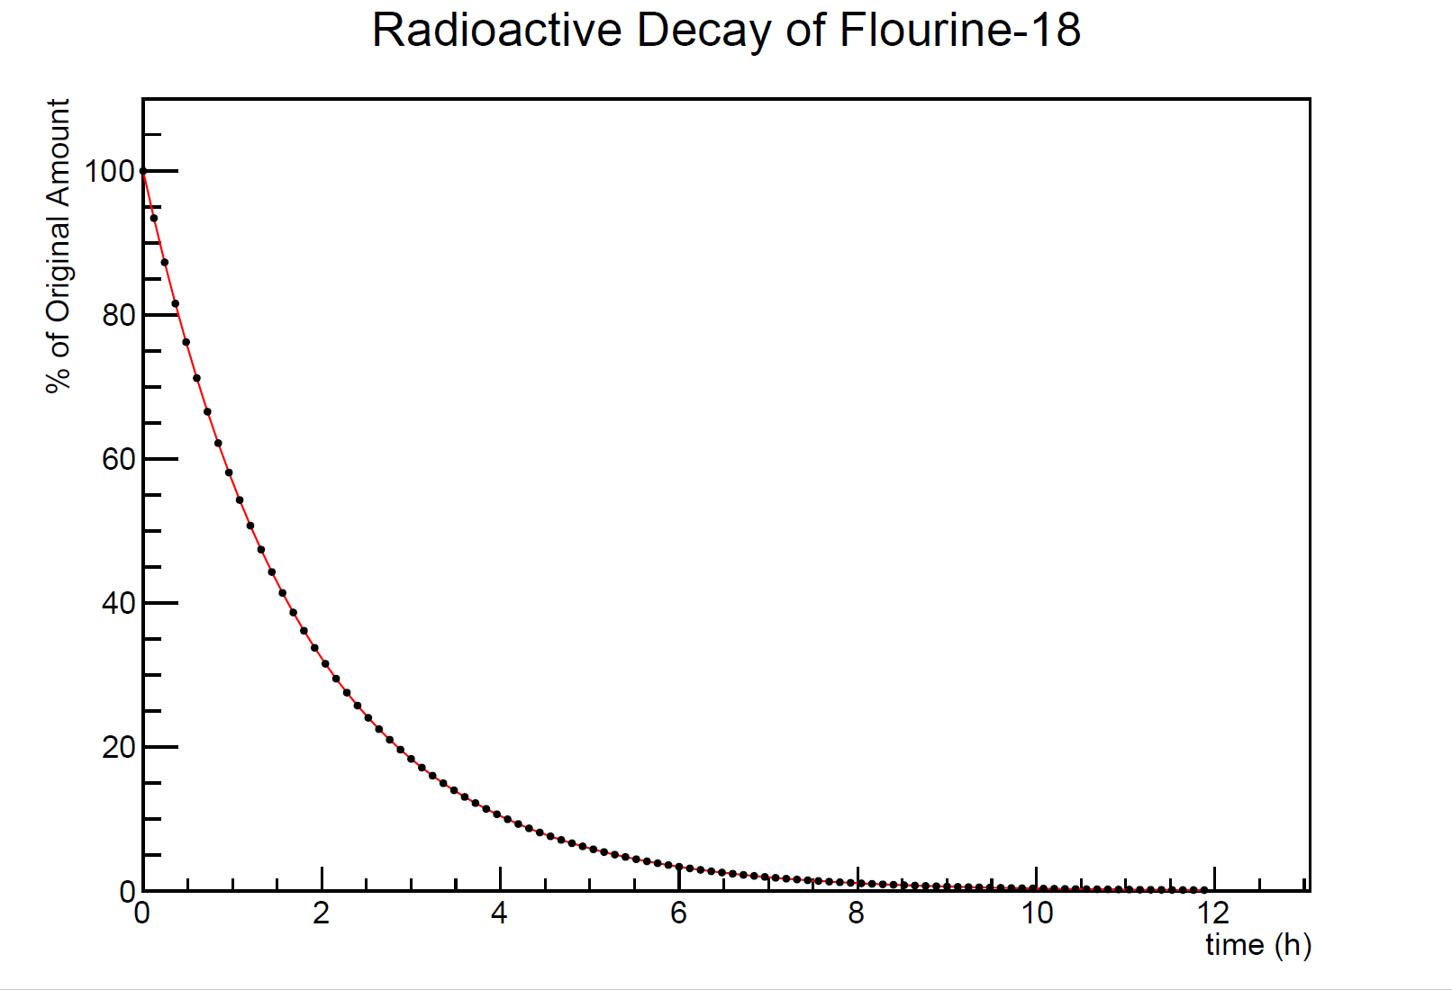

Slide 12
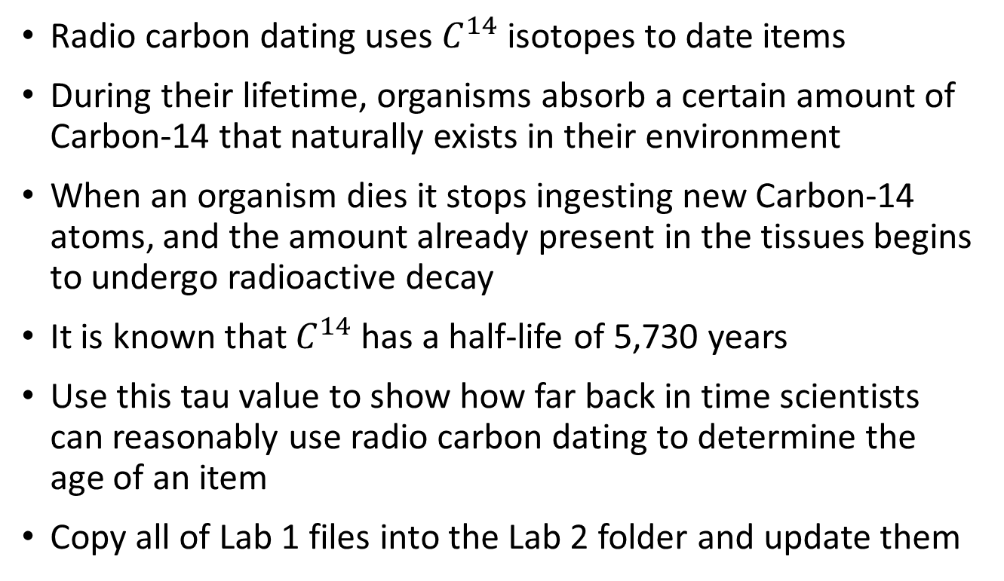
Lab 2 – Modelling Carbon-14 Decay
Radio carbon dating uses $C^{14}$ isotopes to date items
During their lifetime, organisms absorb a certain amount of Carbon-14 that naturally exists in their environment
When an organism dies it stops ingesting new Carbon-14 atoms, and the amount already present in the tissues begins to undergo radioactive decay
It is known that $C^{14}$ has a half-life of 5,730 years
Use this tau value to show how far back in time scientists can reasonably use radio carbon dating to determine the age of an item
Copy all of Lab 1 files into the Lab 2 folder and update them

Slide 13
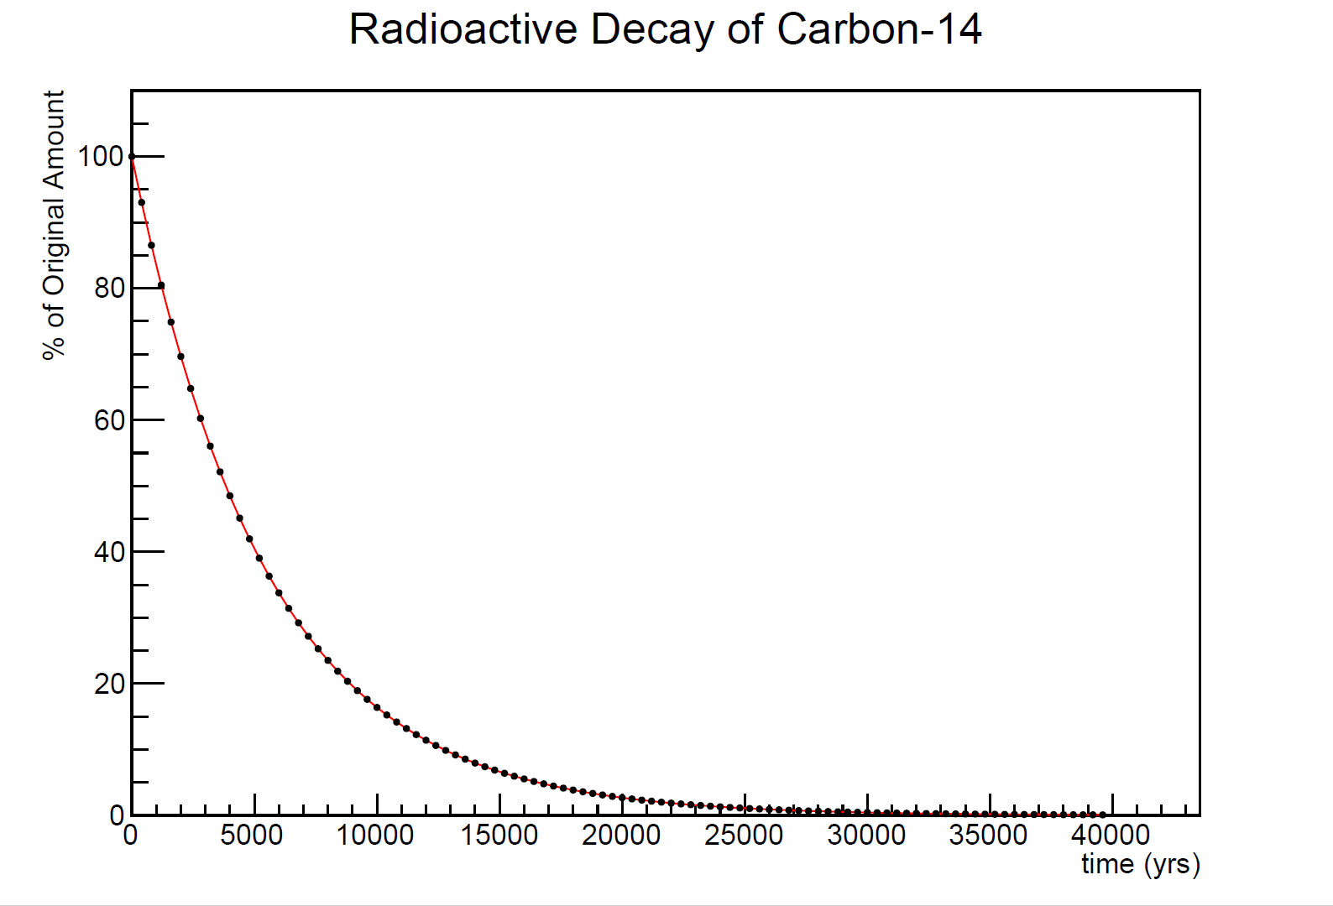

Slide 14
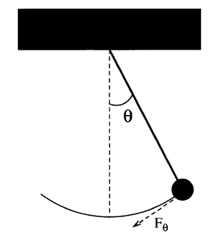
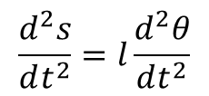


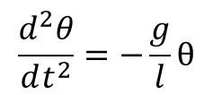




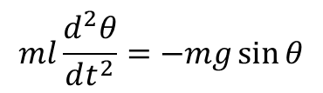

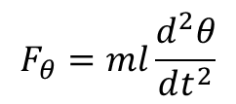

Modelling a Simple Pendulum
$$F_{θ}=−mg\sin{θ}$$
$$ml\frac{d^{2}θ}{dt^{2}}=−mg\sin{θ}$$
$$l$$
$$\sin{θ}≈θ \left(θ<{22}^{°}\right)$$
$$\frac{d^{2}θ}{dt^{2}}=−\frac{g}{l}θ$$
$$s=lθ$$
$$F=ma$$
$$\frac{d^{2}s}{dt^{2}}=l\frac{d^{2}θ}{dt^{2}}$$
$$F=m\frac{d^{2}s}{dt^{2}}$$
$$\frac{dω}{dt}=−\frac{g}{l}θ$$
$$F_{θ}=ml\frac{d^{2}θ}{dt^{2}}$$
$$\frac{dθ}{dt}=ω$$

Slide 15




Modelling a Simple Pendulum
$$l$$
$$\frac{dω}{dt}=−\frac{g}{l}θ$$
$$ω_{i+1}=ω_{i}−\frac{g}{l}θ_{i}Δt$$
$$\frac{dθ}{dt}=ω$$
$$θ_{i+1}=θ_{i}+ω_{i}Δt$$

Slide 16
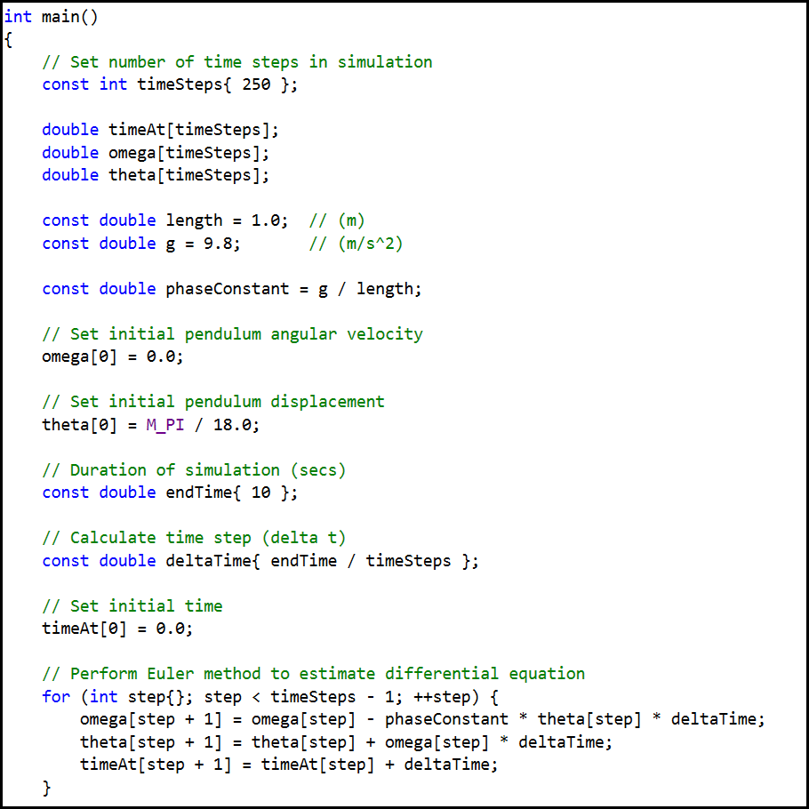

Lab 3 Harmonic Motion
$$ω_{i+1}=ω_{i}−\frac{g}{l}θ_{i}Δt$$
$$θ_{i+1}=θ_{i}+ω_{i}Δt$$

Slide 17
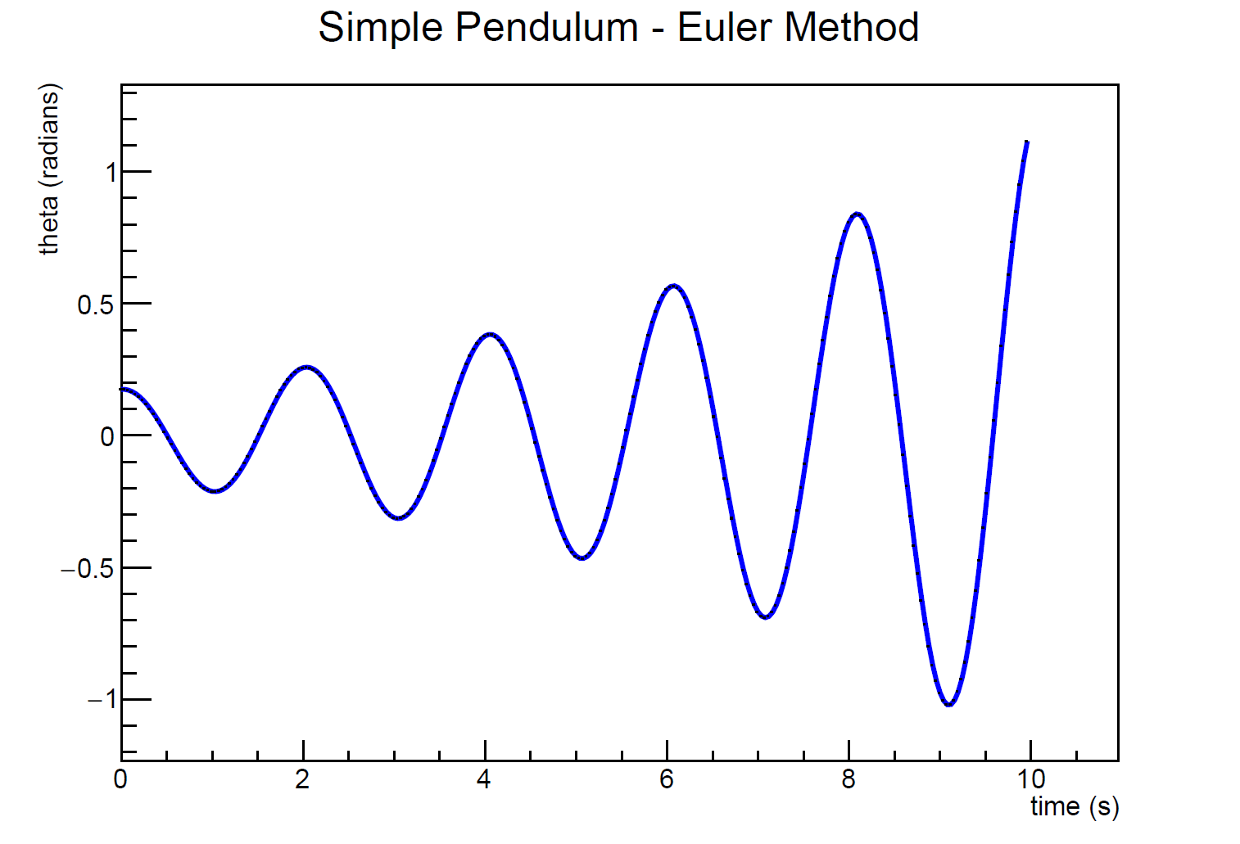
Lab 3 – Harmonic Motion
This is not good… The model predicts the pendulum will begin to swing wildly, which should not naturally happen!

Slide 18

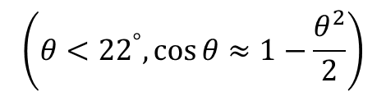


Lab 3 – Harmonic Motion
Try increasing timeSteps by 10x – does the displacement continue to grow after each oscillation?
This simple Euler method worked fine for modelling radioactive decay – but for harmonic motion it is unstable
The energy in the system continues to grow over time without bounds
$$E=\frac{1}{2}ml^{2}ω^{2}+mgl(1−\cos{θ})$$
$$\left(θ<{22}^{°},\cos{θ}≈1−\frac{θ^{2}}{2}\right)$$
$$E=\frac{1}{2}ml^{2}\left(ω^{2}+\frac{g}{l}θ^{2}\right)$$
$$E_{i+1}=E_{i}+\frac{1}{2}mgl\left(ω^{2}+\frac{g}{l}θ_{i}^{2}\right){\left(Δt\right)}^{2}$$

Slide 19
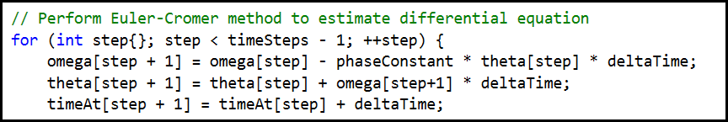
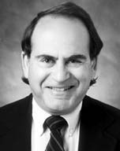
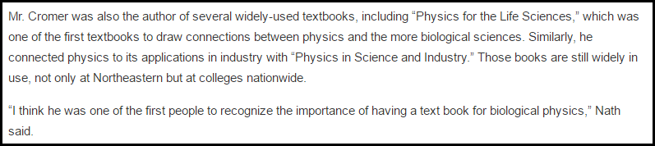
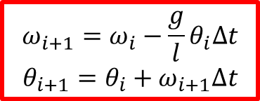
Lab 4 – Harmonic Motion : Euler-Cromer
$$ω_{i+1}=ω_{i}−\frac{g}{l}θ_{i}Δt$$
$$θ_{i+1}=θ_{i}+ω_{i+1}Δt$$

Slide 20
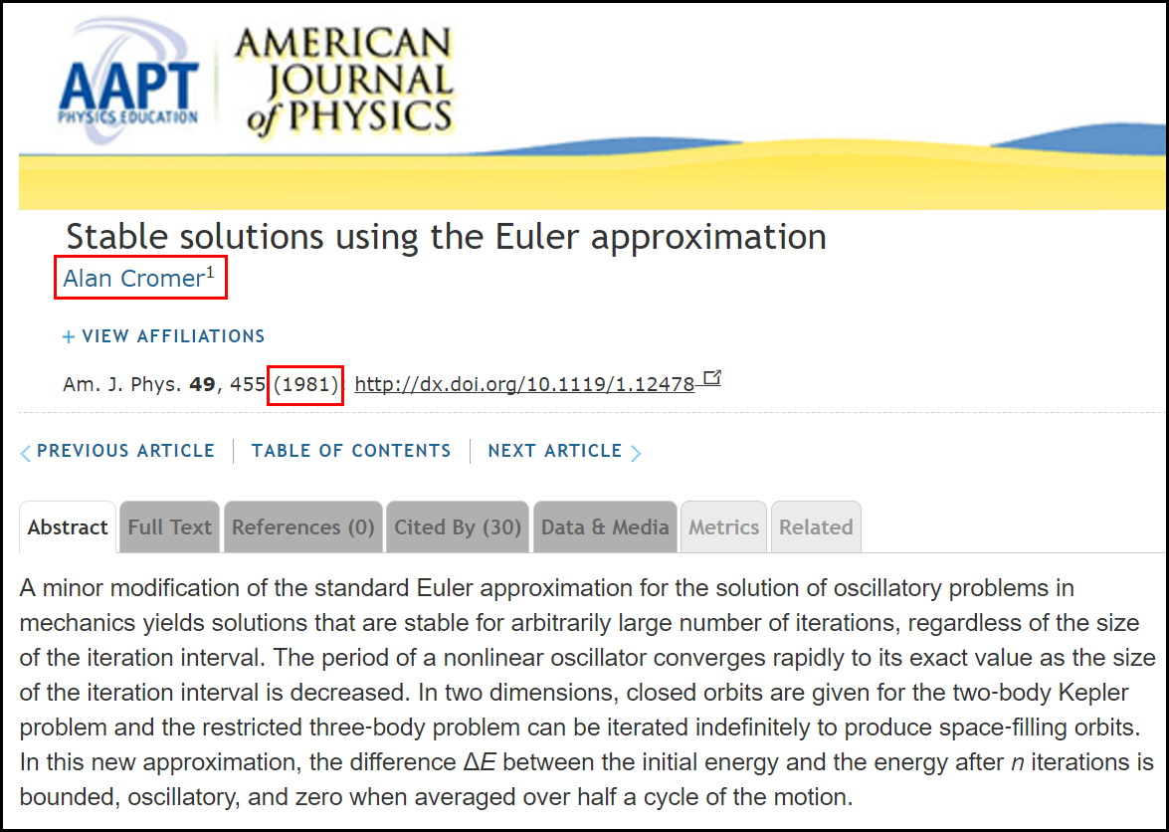
Lab 4 – Harmonic Motion : Euler-Cromer

Slide 21
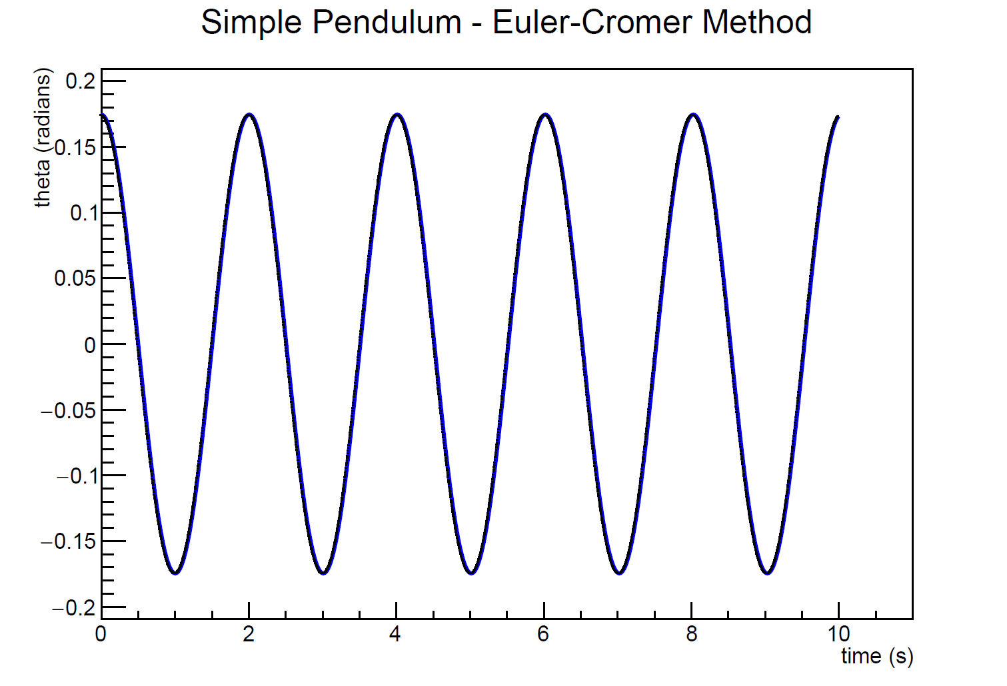
Lab 4 – Harmonic Motion
The model is now stable. Future iterations of the numerical method do not add energy to the system.

Slide 22
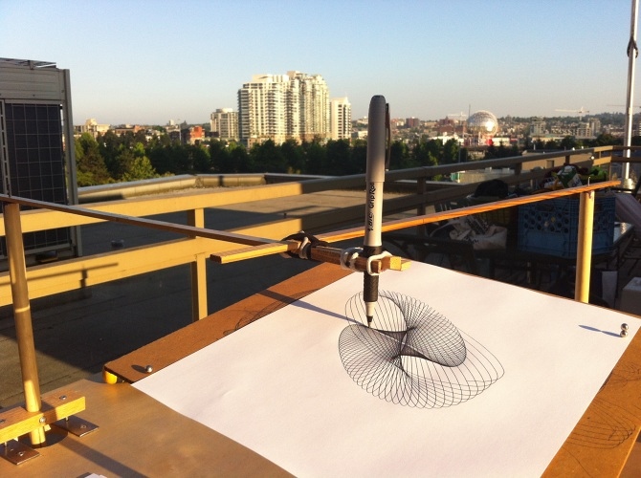
Lab 5 – Coupled Harmonograph

Slide 23
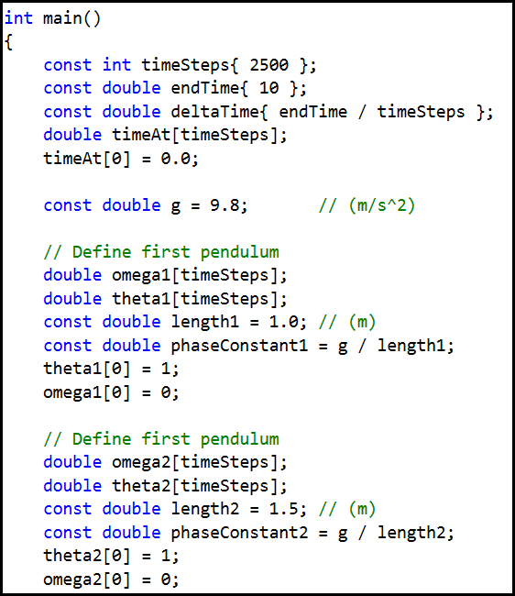
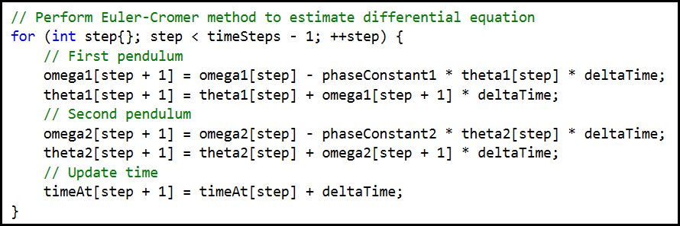
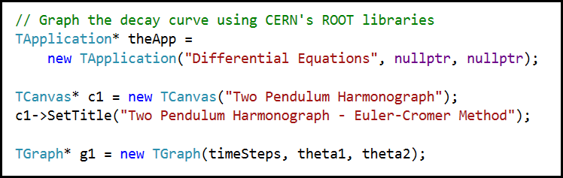
Lab 5 – Coupled Harmonograph

Slide 24
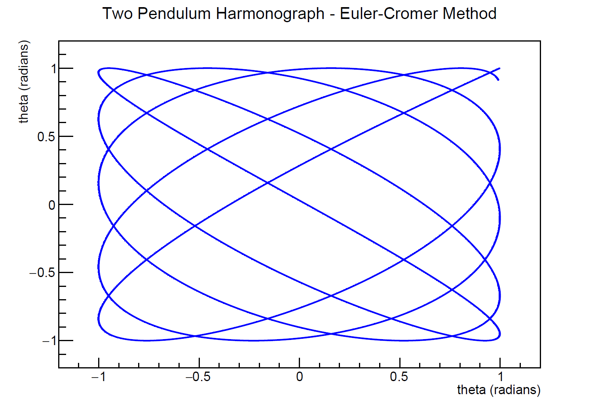
Lab 5 – Coupled Harmonograph

Slide 25
Now you know…
Euler’s Method (time step analysis) yields numeric solutions to differential equations
We model 2nd order differentials by representing them as a chain of linked 1st order equations
Euler-Cromer is better when modelling harmonic oscillators
Increasing # of time steps improves the accuracy of the estimations but causes longer run-times

